Slide 1
LONDON TRIP 2023 Monday 26th June – Wednesday 28th June

Slide 2
Staff
Ms Naylor Mr Webster Mrs Lewis Miss Newton

Slide 3
What to Wear
Tracksuit bottoms
School hoodie
T- shirt
Trainers or walking style boots
Needs to be practical and as we are representing school, appropriate

Slide 4
What to pack….
Monday - Lunch and snacks to have in a plastic bag that can all be thrown away
Water Bottle (full) - no energy drinks or cans
Any snacks for the Tuesday / Wednesday if you wish (school will provide)
School will provide toiletries
Pyjamas
Hair brush
2x Underwear
Clothes for Tuesday and Wednesday
Sun cream / hat / sunglasses
Rain coat
Medication (Adult distributed medication to be given to office prior)
A rucksack / backpack is imperative as wheelie suitcases are not able to be stored at the museum.

Slide 5
What to pack….
NO DEVICES ALLOWED
We will update parents about the trip by text and Facebook
We will only contact you if needed

Slide 6
The Itinerary- Day 1 - MONDAY

Slide 7
Slide 27
Meet at school at 9am promptly
Hand over medication

Slide 8
Slide 27
9:40am- Train to Euston
Children will be sat in pairs on carriage.
Can play cards/ read a book
Can have a snack and drink

Slide 9
Arrival- 12:15 Drop off bags at Hotel

Slide 10
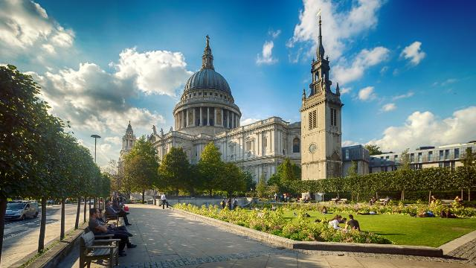
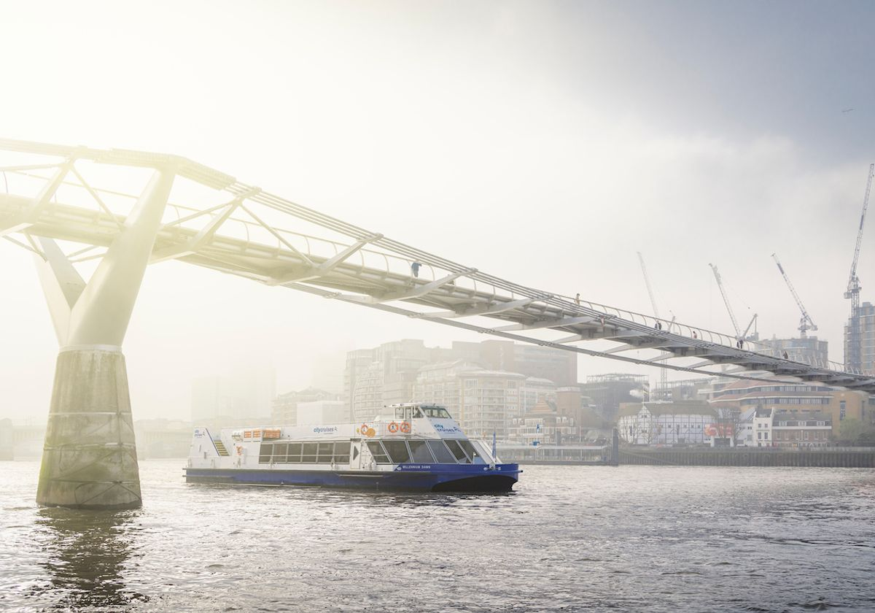
1:30pm Lunch
2:30pm – 5:00pm River Cruise
Children will eat their packed lunch outside the British Museum
Walk to Tower Bridge
3:15pm River Cruise on the Thames from Westminster Bridge

Slide 11
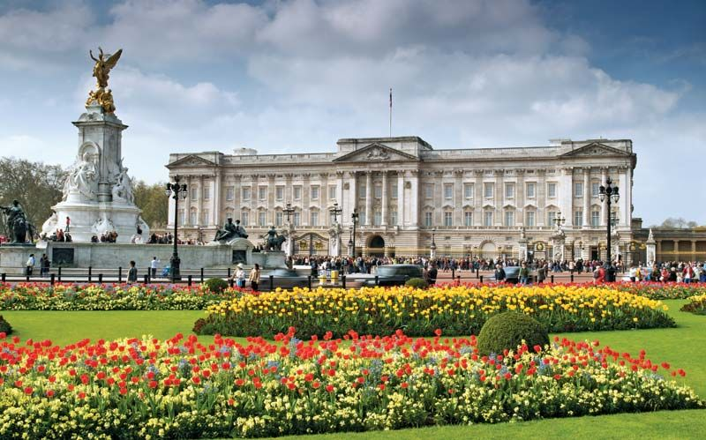
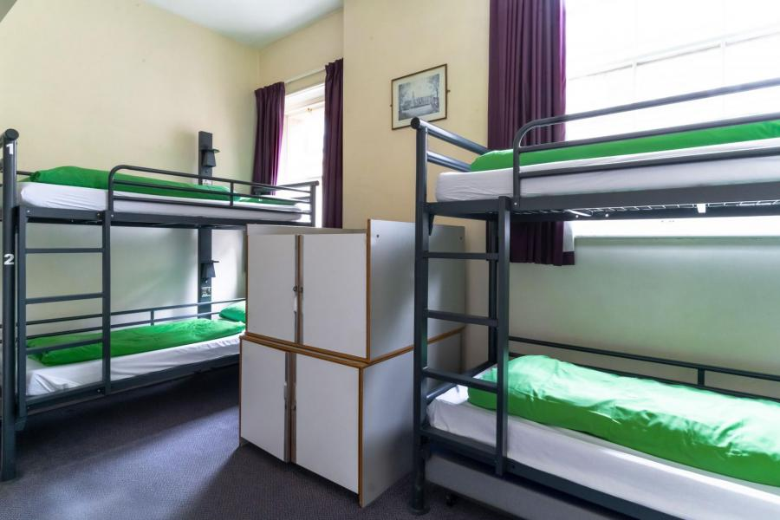
5:00pm- Check in 6:00pm – Pre-booked evening meal
Walk to Buckingham Palace and Covent Garden to see the performers
10pm – Lights out

Slide 12
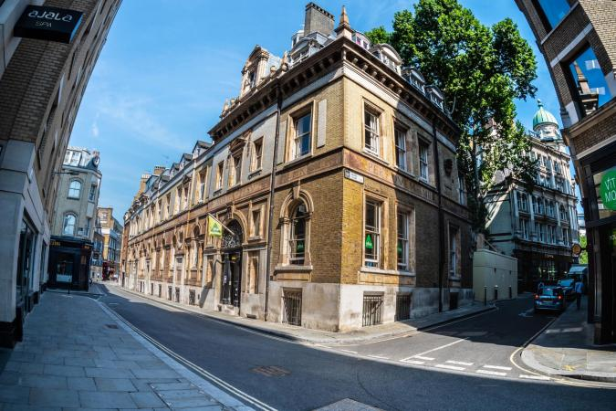
Day 2 – Tuesday

Slide 13
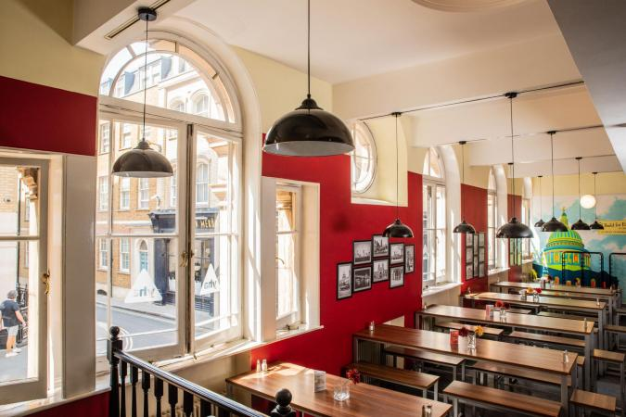
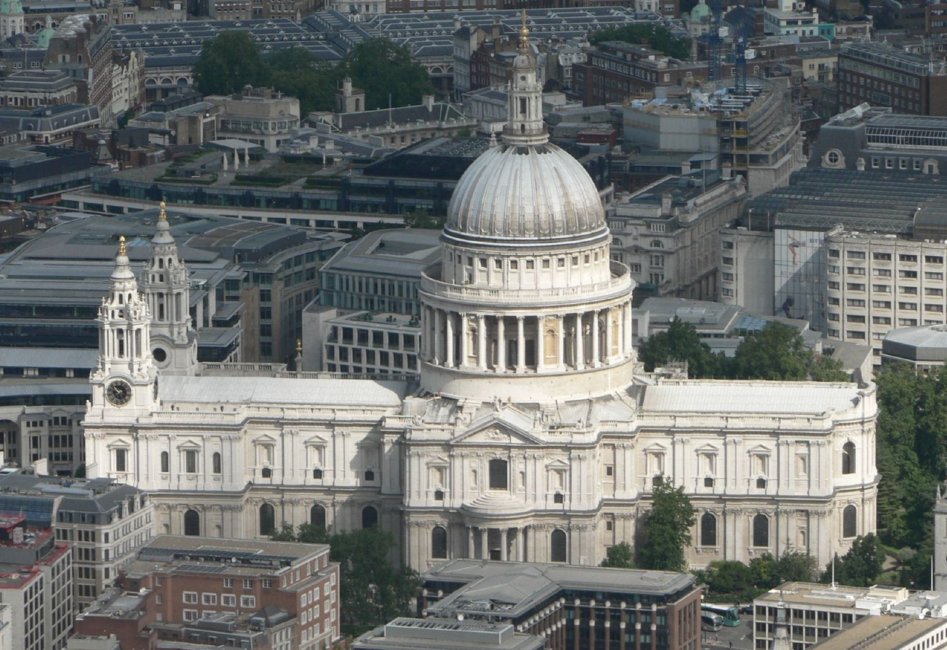
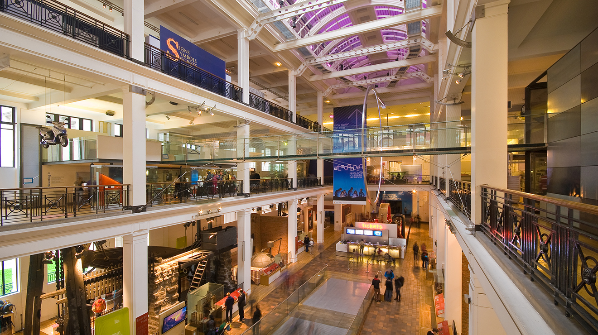
7:00am – Up and dressed 7:30am – Breakfast in the hostel Given pre-selected packed lunch
9:00am Visit to St Paul’s Cathedral 11:30am Science Museum Viewing ‘A Beautiful Planet’ IMAX

Slide 14
7:30pm Mrs Doubtfire Show
Back to the hostel, ready for bed and lights out
4:30pm Back to the hostel 5:30pm Pre-selected evening meal 6:15pm- Set off for Shaftesbury Theatre Toilet and seated We are all sat together

Slide 15
Day 3 - Wednesday

Slide 16
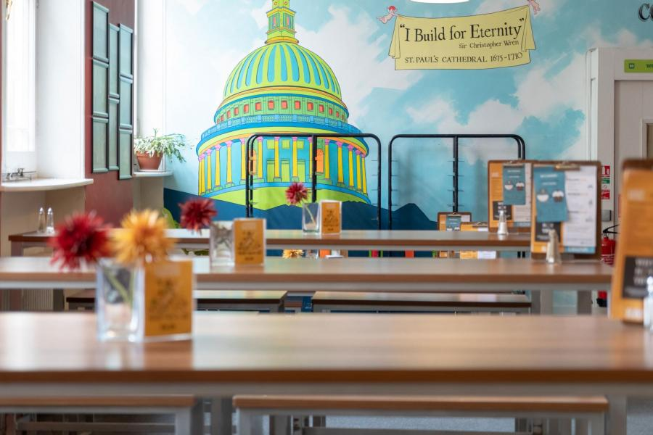
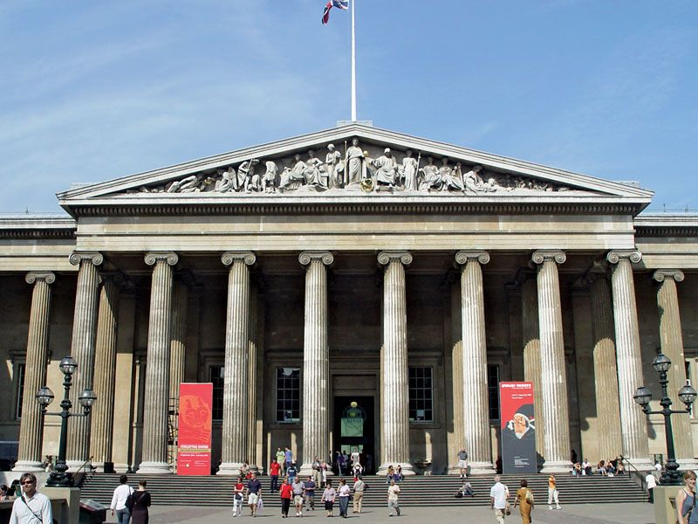
9:00am Walk to British Museum and put luggage in lockers – no wheeled cases or large items
11:30am – Eat lunch 12:30 Visit Regents Park with groups of children going to the
7:00am Up, shower, dressed and packed
8:00am Breakfast Collect pre-selected packed lunch

Slide 17
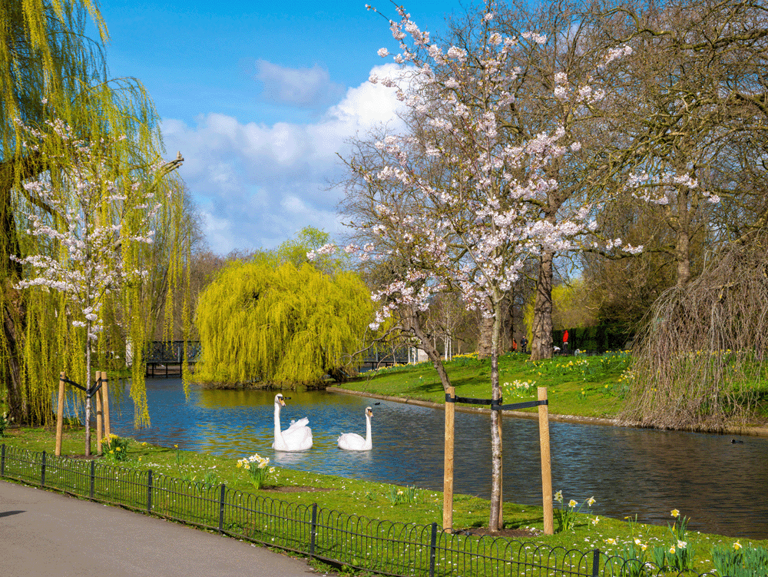
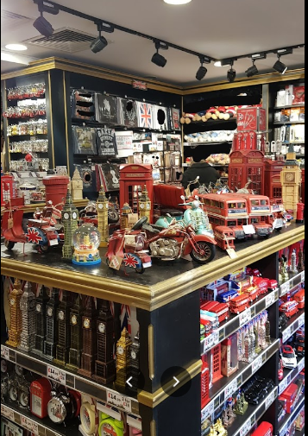
11:30am – Eat lunch at the British Museum Visit Regent’s Park with groups of children going to The Regent Gift Shop to purchase mementos to bring home

Slide 18
Slide 27
2:30pm- 4:56pm Train from Euston to Lancaster
Parents collect children from Lancaster Train Station Children will be sat in pairs on carriage.
Can play cards/ read a book
Can have a snack and drink

Slide 19
Slide 27
Thursday – Central children have their transition day
All other children due into school for 10:30am

