Slide 1

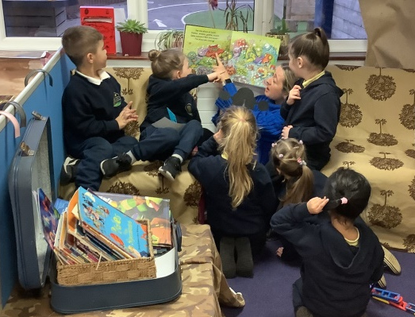
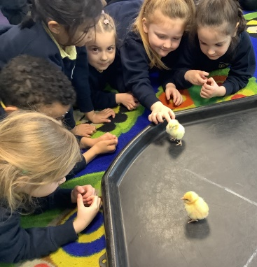
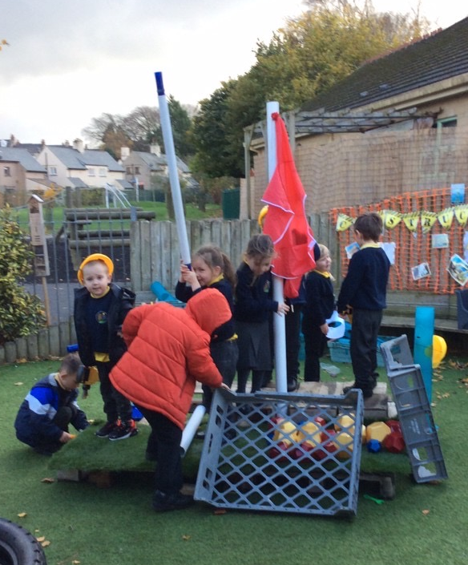
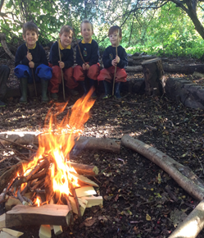
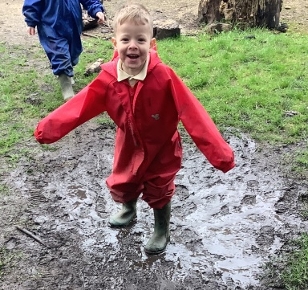
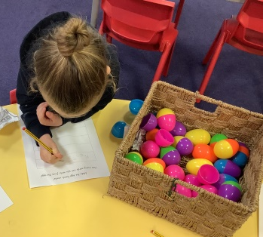
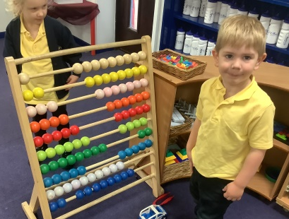

Welcome to Reception

Slide 2
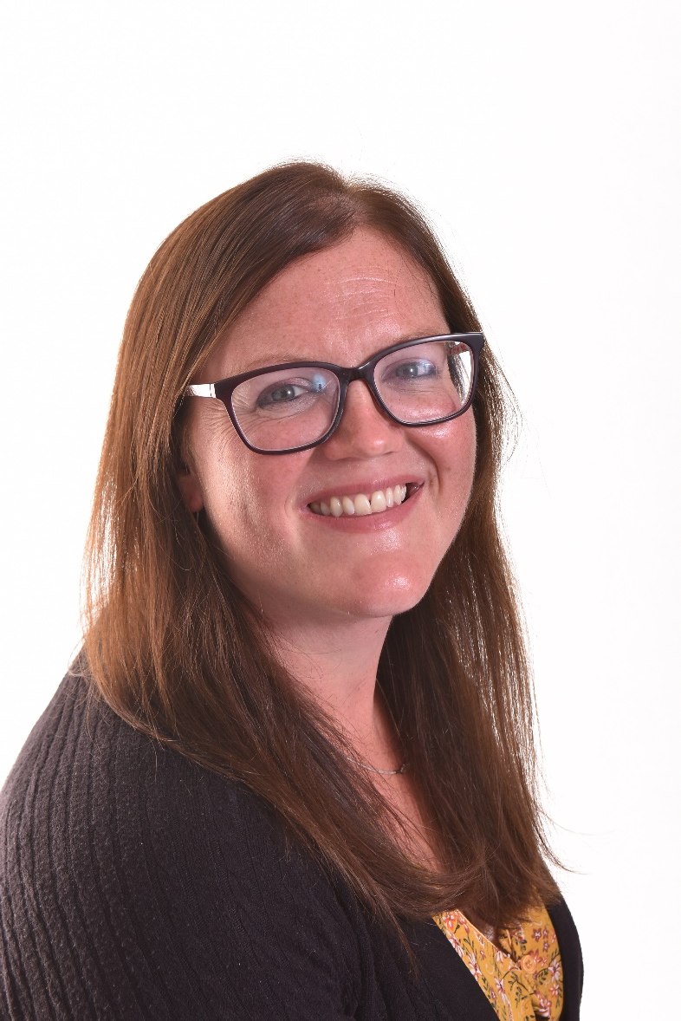
Your EYFS team
Miss Susie Frankland
Class Teacher
Notes:
Who we are

Slide 3
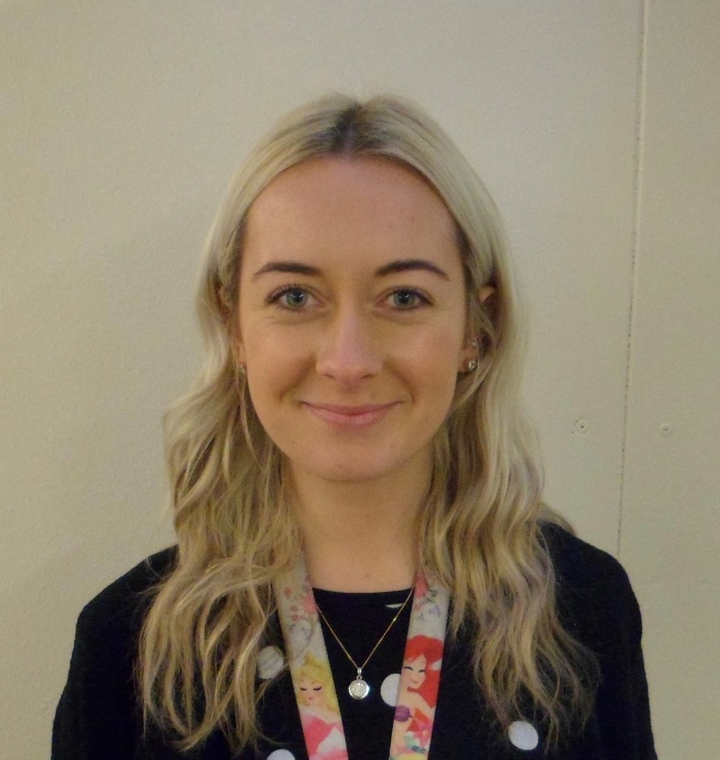
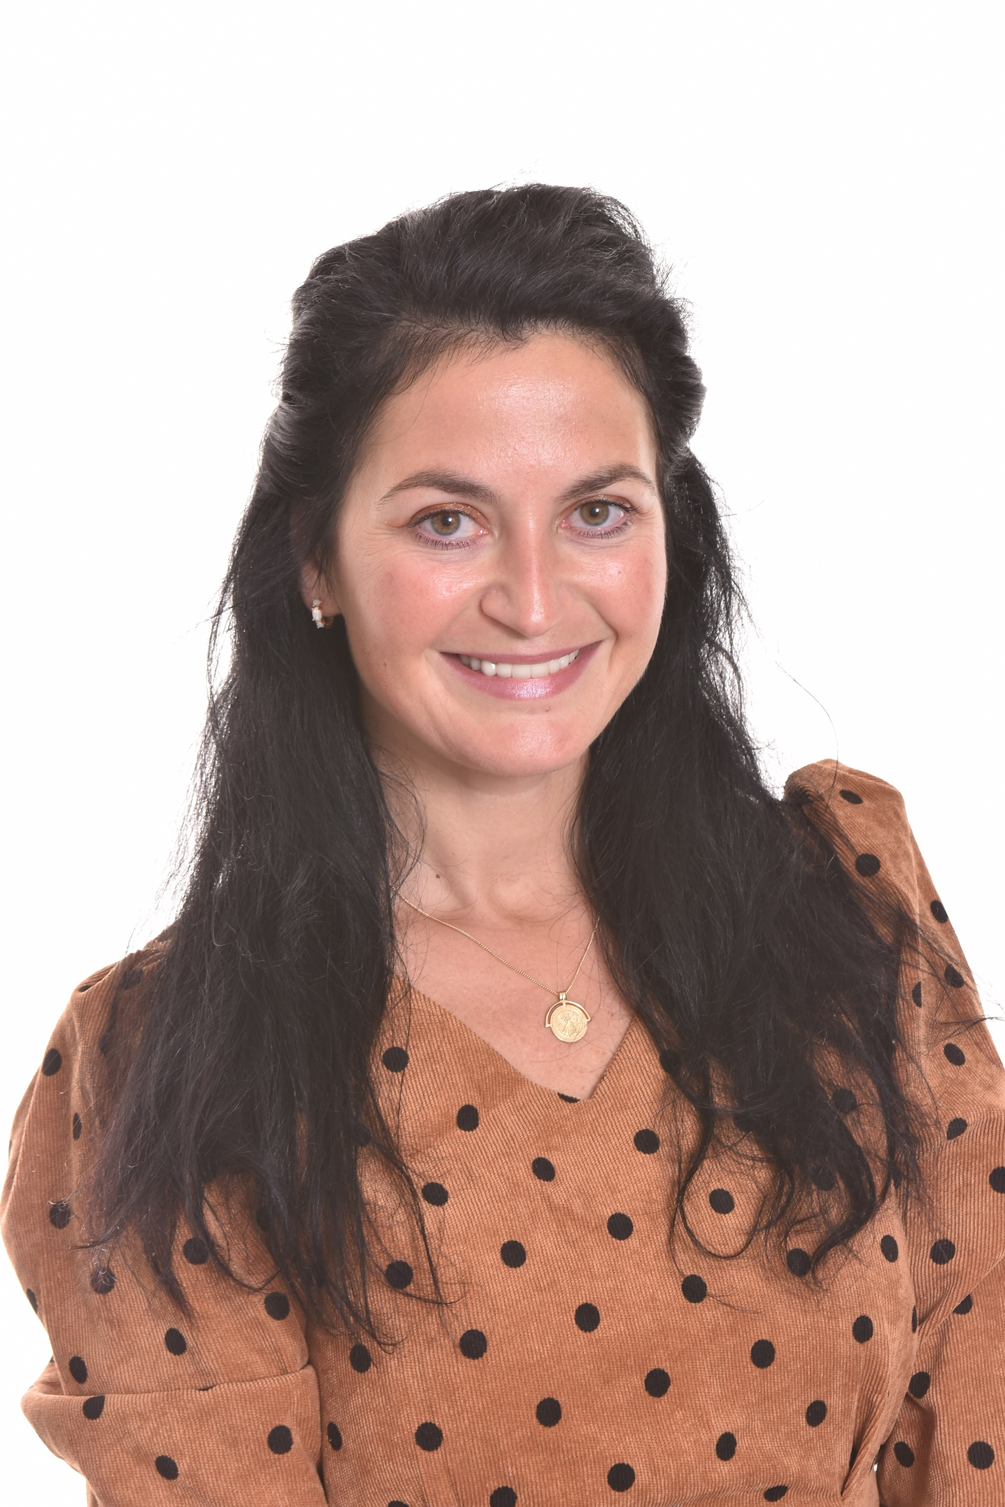
Mrs Chloe Turner
HLTA (Higher Level Teaching Assistant)
Mrs Carolina Seredenco
TA (Teaching Assistant)

Slide 4
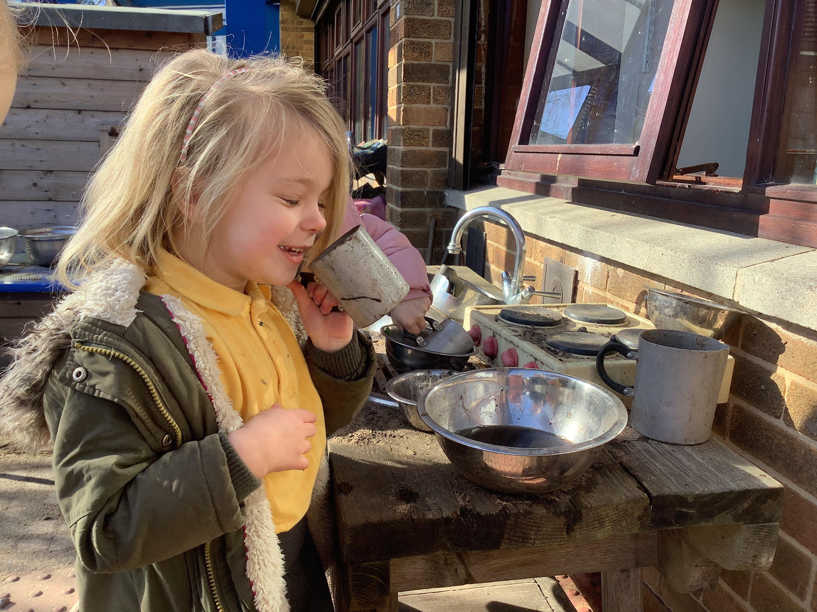
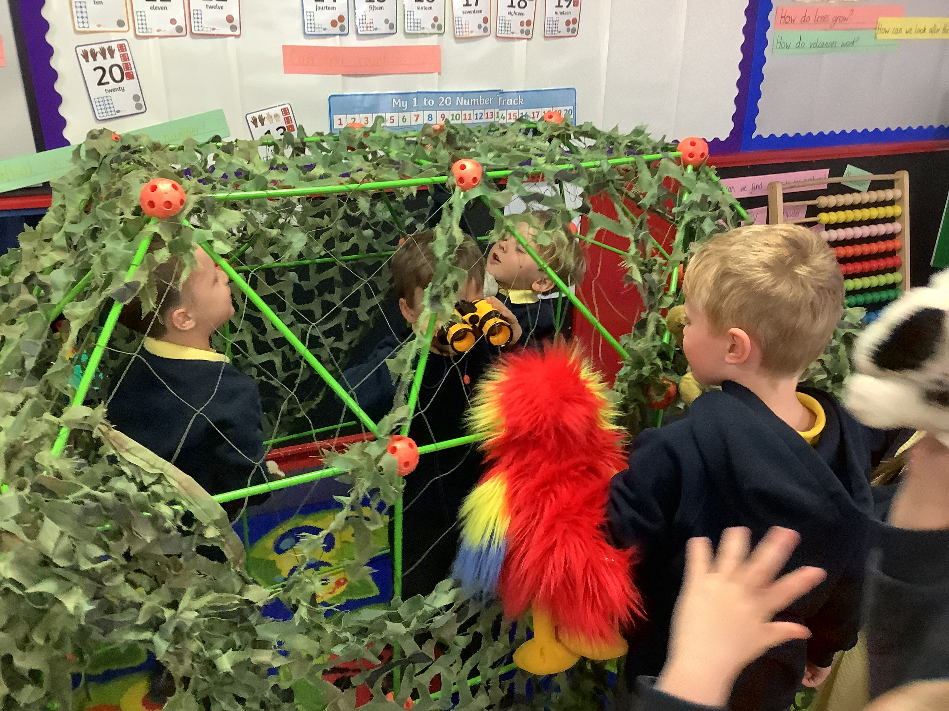
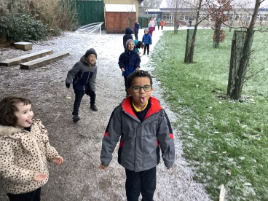
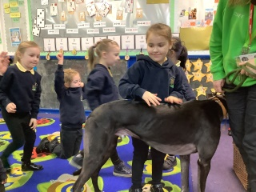
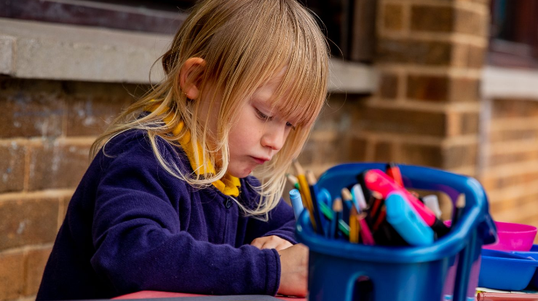
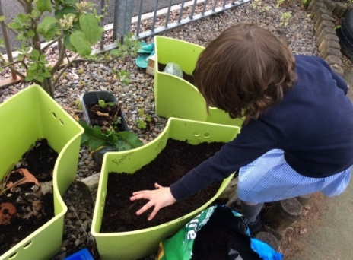
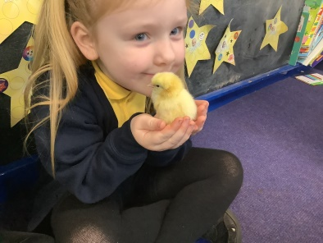
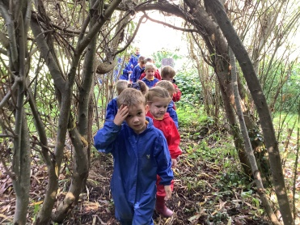
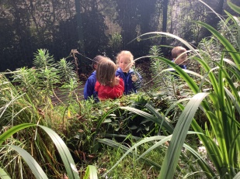
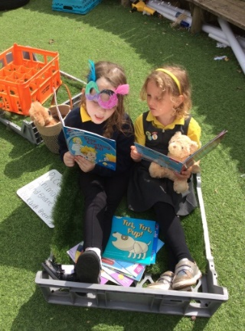
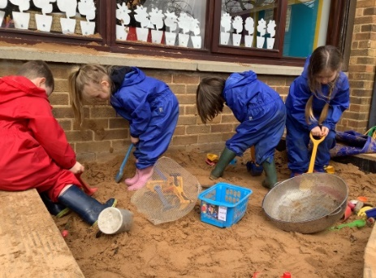
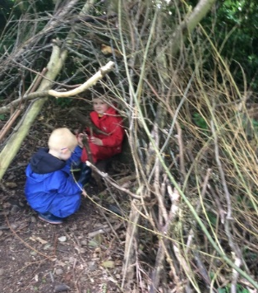
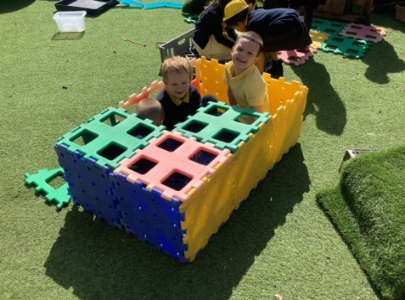
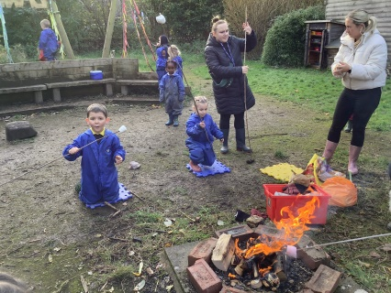
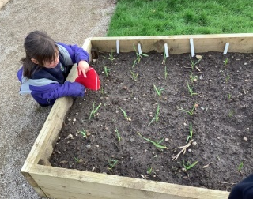
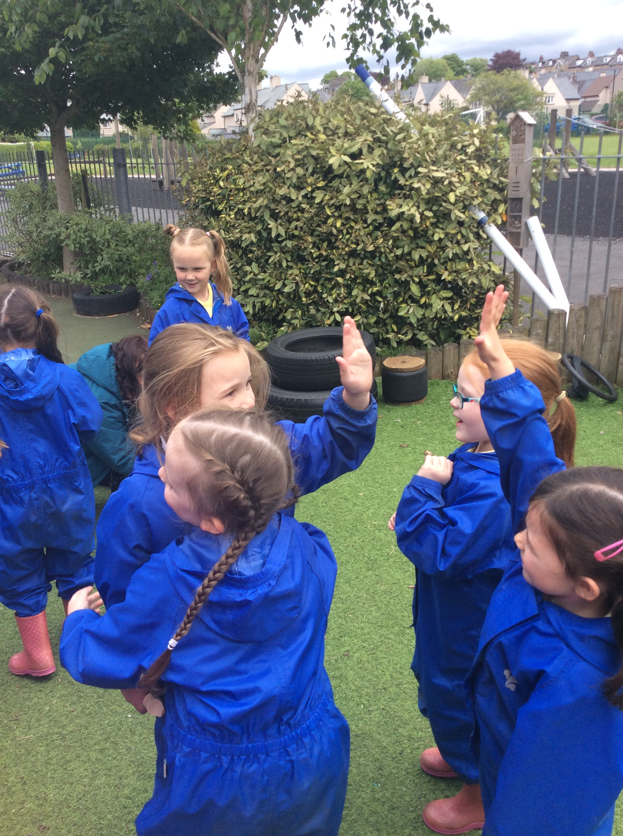
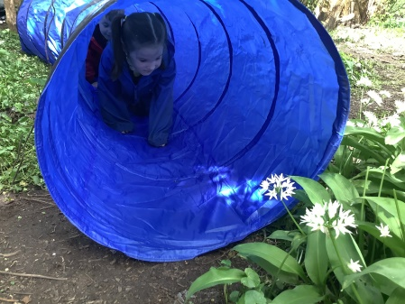
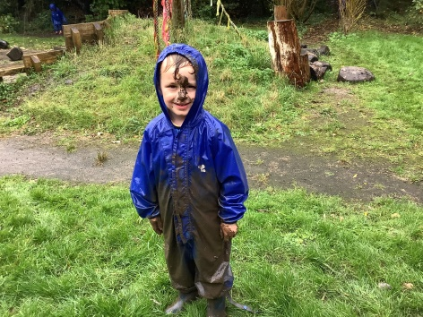
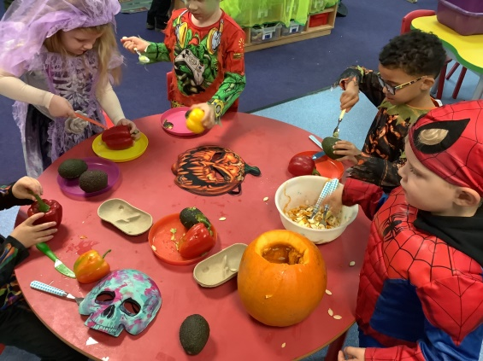
EYFS profile: The whole child
Notes:
Here at Willow Lane School the children are at the heart of everything we do. They are encouraged to learn to the best of their abilities but we also want them to have fun along the way - to understand nature by growing vegetables and exploring our wildlife area, to develop confidence through drama and singing, to develop positive human values by caring for each other and making links in the local community which we are proud to serve.
Our creative and inspiring curriculum means that children are encouraged to follow their ideas and thoughts whilst gaining independence. Through the use of the Early Years Foundation Stage Profile we can ensure that children gain the bespoke teaching they need in order to develop all aspects of their learning in a fun and exciting way.

Slide 5
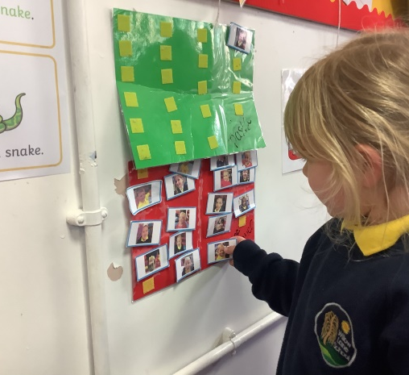
A day in EYFS
Self-register
Notes:
All children react differently when starting school. Some are so eager you don’t get a goodbye and others won’t let go of your leg! This is perfectly normal. We understand that every child is different and we hope to make the transition into school as easy as possible.
A breakfast bar is open from 8.25 in the hall. Children can start coming into the classroom at 8.40. Children need to be in school by 8:50.
If children are not coming from Whoosh club or the breakfast bar, then they will need to enter the classroom from the KS1 corridor.
Developing independence is a key part of their journey in Reception. Children put away their coats and bags and register their dinner choices.

Slide 6
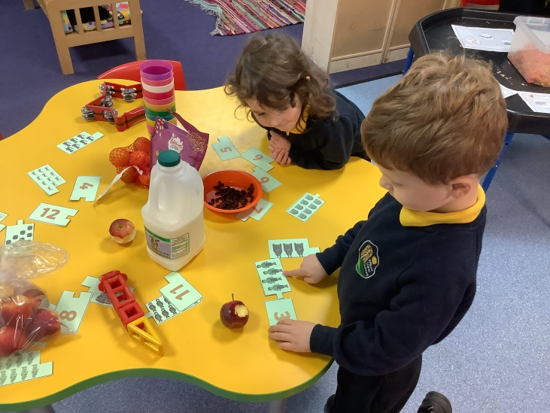
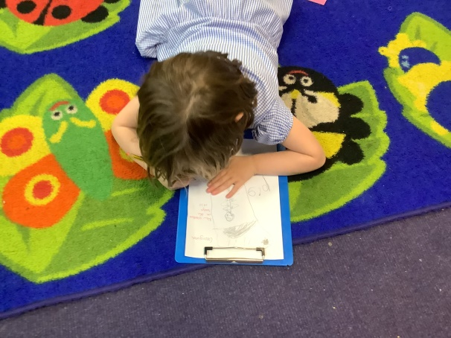
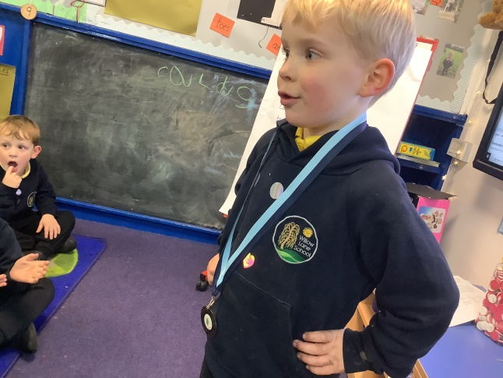
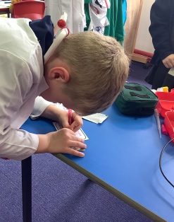
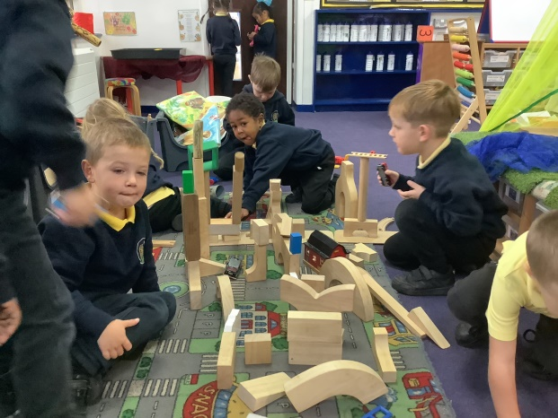
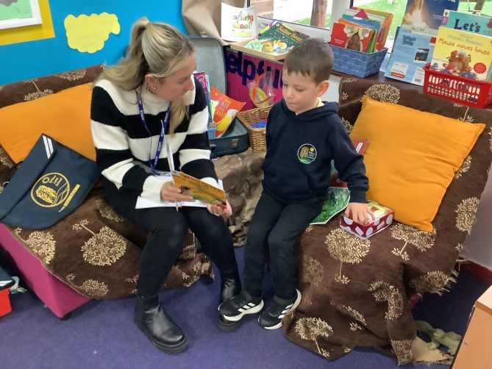
Morning
Session 1
Notes:
The school day starts at 8.45am.
Children are able to choose how they start their day. Some like to start with a snack, some like to get stuck in to activities straight away, some prefer to sit in the reading area with a book and a reading buddy.
During this time, the adults in the class chat with the children, monitor reading records, and work with small groups.
We call this time 'discovery time' as the classroom environment is set up so children can always discover something new.
At 9:15 the children will begin ‘drawing club’ where they will listen and respond to a story in a fun and creative way.

Slide 7
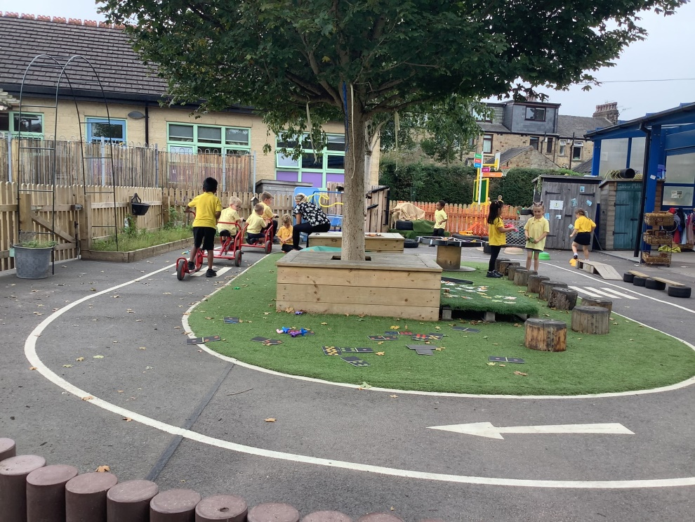
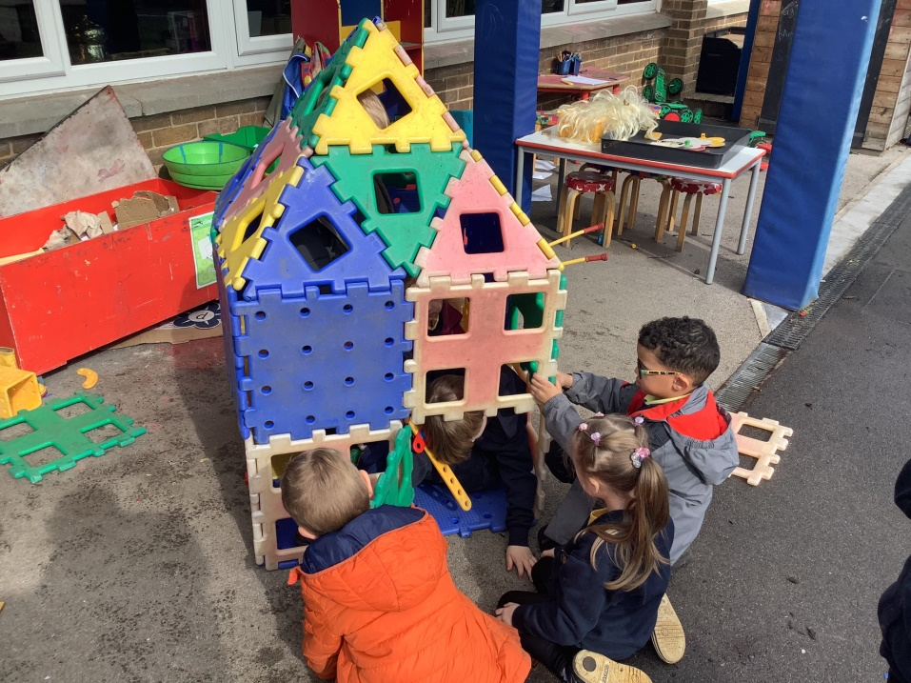
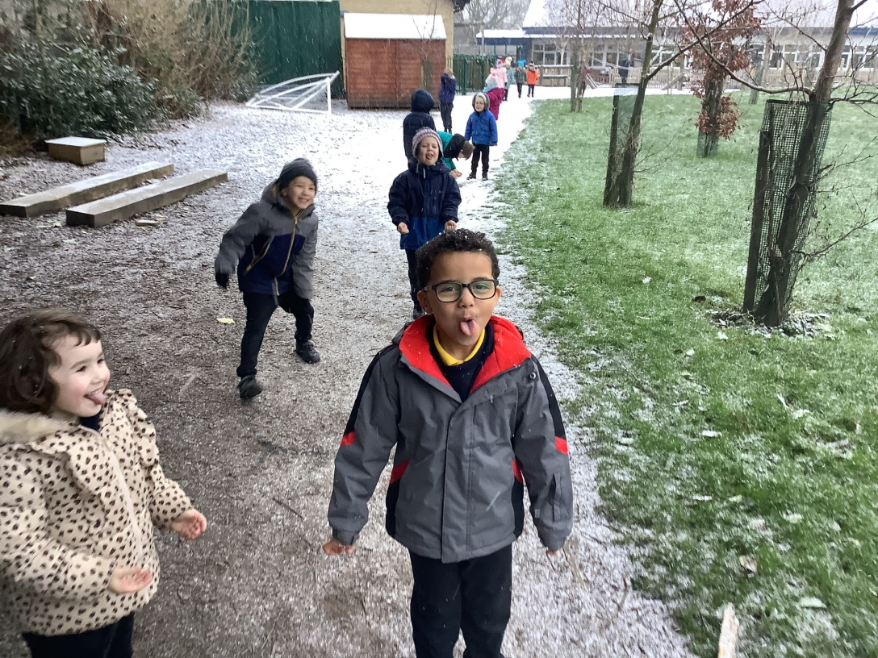
Break time
Notes:
Break time is at 10.25. At first, we start playtime in the Reception area and then extend playtime to other areas. We use the outside provision all day but this is an opportunity for the children to interact with other children in school. All children are very welcoming of the children in Red class.

Slide 8
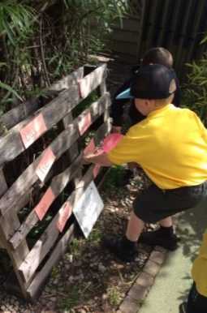
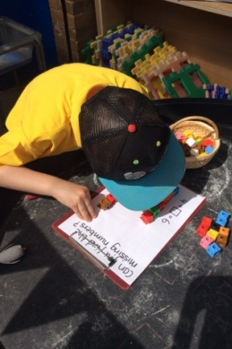
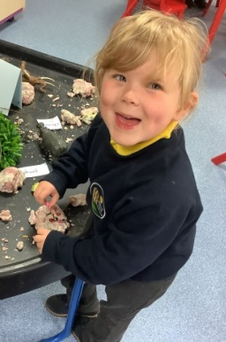
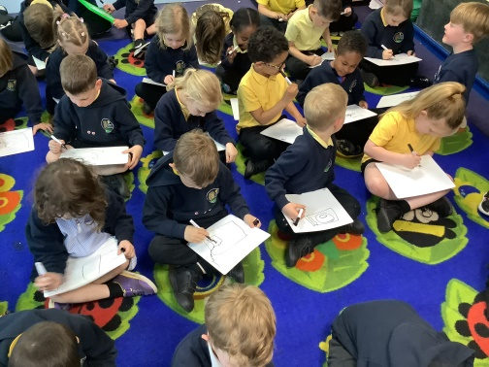
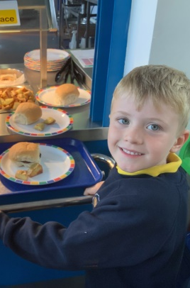
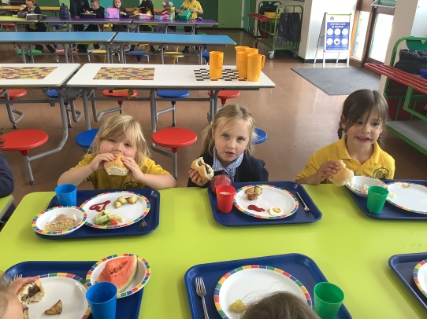
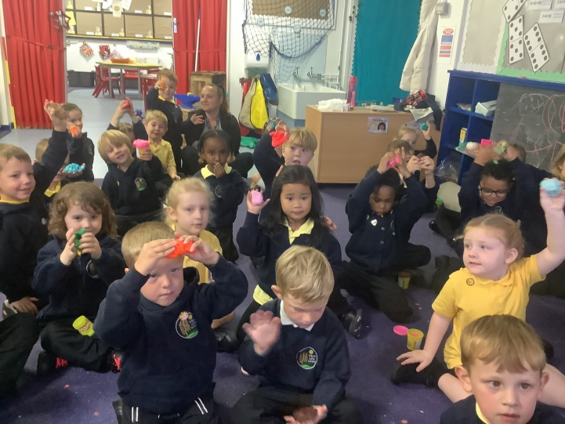
Morning
Session 2
Notes:
At 10.40 it's back to class and children are taught phonics as a whole class. Later in the year, they will be split into smaller groups to do more focused learning. At around 11:00 children can 'Discover'. The outside area is a popular place at this time.
By 11:45pm, hands are washed and children are ready for their dinner which they collect themselves from the hall. After that it's playing outside with all of the children from the whole school. Supervised by an adult for each class with lots of playtime equipment to choose from, and a the range of the school grounds when the weather permits.

Slide 9
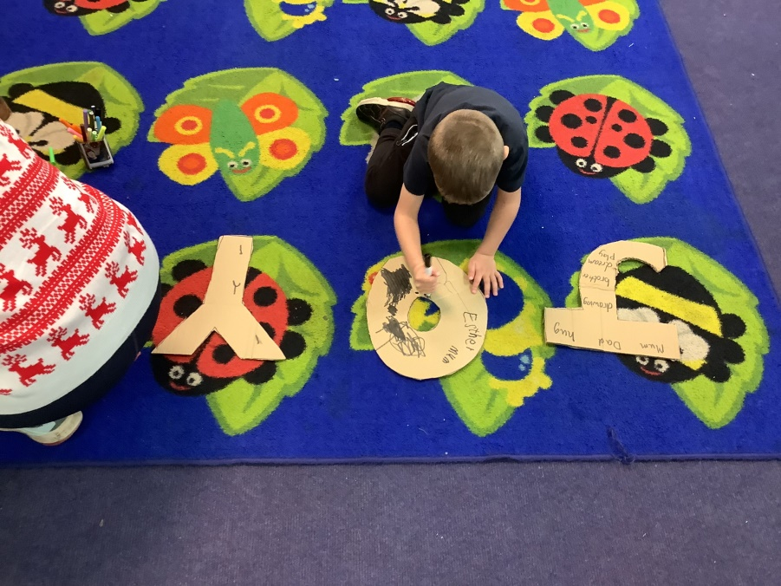
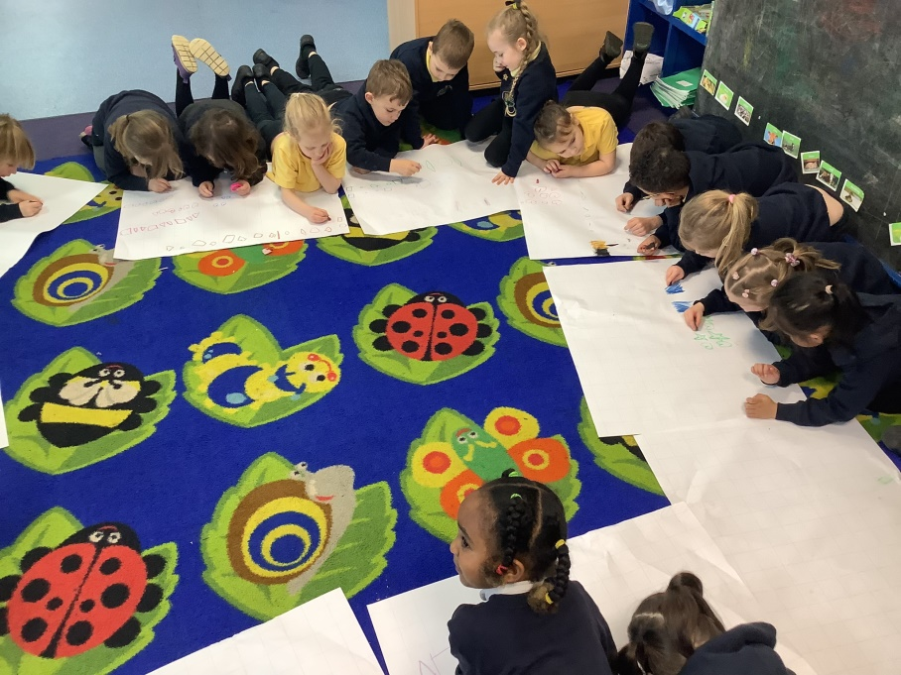
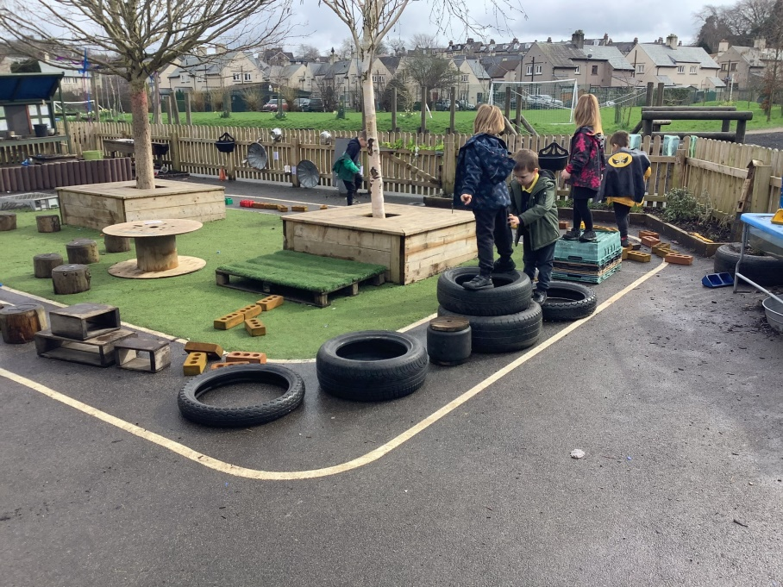
Afternoon session
Notes:
At 12.45pm the children are back in class ready for another whole class lesson. There are a range of activities linked to their learning and the specific skills and experiences they need to explore. Children will also work in with an adult in small groups on specific tasks, be listened to read, as well as the normal high-quality interaction you would expect to help them achieve their early learning goals.

Slide 10
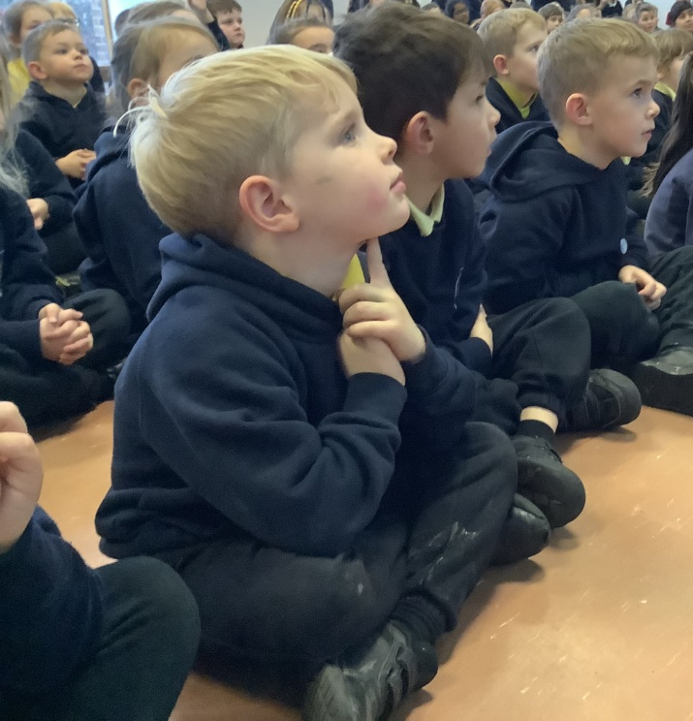



Afternoon and home time
Notes:
By the end of the afternoon, children will have had a range of learning experiences and full of things to share with the class. We will bring the children together towards the end of the day to celebrate specific learning and behaviour. Children will hear a story, sing a song, or attend a whole school assembly.
At 3:15 it's time for home. Children are collected one at a time from the entrance to the outside area of Early Years. The children wait for their teacher to call them when their adult has arrived. If you are arranging for someone else to collect your child, please let the office know in advance.

Slide 11
Early reading and maths

Slide 12


Early Reading with your Child

Slide 13

How the journey begins
In the first few weeks of Reception, your child will begin focussing in on sounds in words. They will listen for initial sounds, rhyming words and begin oral blending. At this stage, they will not see letters written down. They will play active listening games and begin to hear initial sounds (e.g. the s in sun Next, they will play games such as sorting objects with the same initial sounds.

Slide 14


Ways to help with this
Read a story book to your child at bed time (and at other times of the day if they wish) It doesn’t matter if they hear the same story again and again. It’s good to develop favourites. Talk about favourite parts and characters
Ask your child to find a toy beginning with a letter e.g. c c c car or t t t teddy
Speak in sound talk e.g. go and get your b.a.g or c.oa.t and see if they can work out the word

Slide 15



Letters and Sounds
After a few weeks (when they are ready), your child will begin to learn letters and sounds. They will learn to read the sound of each letter and alongside that, blend some together to read words.
They will also learn how to write and form each letter correctly using a picture and easy to remember phrase.

Slide 16



Pure Sounds
At around this time, your child will start bringing books home to read with you at home. At first, they may bring home sound and picture books. Your child will be taught ‘pure sounds’ as this is the easiest way for them to blend the sounds together to read the words. It is very important that you use pure sounds too as then, there is no confusion.
https://www.youtube.com/watch?v=UCI2mu7URBc

Slide 17

Blending
Learning to blend sounds to read words is key in your child’s reading journey. They will practice blending daily in phonics, reading and in every day school life.

Slide 18



More than one letter to make one sound

Slide 19


‘Tricky’ Words
There are words in reading their books that your child will come across that they will not be able to sound out and blend using phonic knowledge. These are known to them as ‘tricky words.’ In school, children are taught to learn to read these on sight rather than trying to sound them out. Here are some examples.

Slide 20
A Huge Difference
Life with children is very busy indeed and every moment can feel full. However, if we can make regular reading at home a priority, this really will make a huge difference to your child’s learning and confidence. The more you read with your child, the more likely they will keep up with their learning in class in most cases. Bringing learning backwards and forwards to school and home helps children’s understanding and development a great deal.

Slide 21


Top Tips for reading with your child
Build it into your daily routine. Set aside a time of day that works for you and your family. This could be in the morning before school, straight after school, after tea or before bed. Commit to doing it as regularly as possible. The benefits are huge
Turn off all screens and put away toys. Have quiet time together
5-10 minutes very regularly over the week is better than one long read
Talk about the front cover before you start. Read the title. What do you notice? Who are the characters? What do you think it will be about?
If the book has focus phonic sounds, go through them before you start. Point them out before, during and after
Ask questions during and after such as ‘What was your favourite part? Why was Kipper sad? There are often ideas for this at the back or front of the book
Lots of praise, encouragement (and sometimes, patience) is key

Slide 22




Pages to help and support

Slide 23

Early Maths

Slide 24




Where do we start?

Slide 25
Counting

Slide 26
Comparison

Slide 27

Composition
5
2
1
2

Slide 28

Pattern

Slide 29
Shape and Space

Slide 30

Measures

Slide 31



How do we teach maths?

Slide 32


What can you do at home?
Lots of talk about numbers
Songs and rhymes
Counting
Play
Baking and crafts

Slide 33
Any Questions?

Slide 34



Home-school expectations
Notes:
We use Tapestry as an online sharing platform. This helps us keep a track of all the achievements and progress your child has made. It also allows us to share with you what they have done. Importantly, it is an excellent space for you to share any learning the children have done at home. The EYFS profile is about the whole child, and a dialogue between parents and school allows us to know and help your child more effectively.
During the first few weeks of school, children will be encouraged to take home a story book which can be read by you.
After 3-4 weeks children will get reading books (don’t worry if they can’t read yet. It is nice to share the book, point out letters and talk about the pictures). We ask that you do this with your child at least 3 times a week, or more, and write a comment about it in their reading records.
We will change their books regularly. Children don't need a new book everyday as re-reading books is an important skill in developing reading fluency and deepening comprehension.
Please ensure book bags are in school everyday and checked each evening for letters and information.
Please make sure that all uniform is named.

Slide 35



Willow Tree Way-
Respectful
Ready
Responsible

Slide 36

EYFS focus
Respectful- We use kind hands and kind voices.
Responsible- We look after our things.
Ready- We listen and try our best.

Slide 37


Dinners, snack, milk

Slide 38

School Uniform – We are active!
School logo navy sweatshirt, cardigan, hoody or fleece.
Yellow polo shirt.
Black leggings or black jogging bottoms, shorts or skort.
Black trainers.
Notes:
All items listed can be purchased at our suppliers in Lancaster – The Uniform and Leisurewear Company.
You can purchase school uniform in store at 15 Common Garden Street, Lancaster, LA1 1XD. This is opposite the bus stops at the back of Primark. They are open 9am-5pm Monday-Saturday and will have some later opening hours during August in the run up to schools starting back in September.
You can also order online at https://www.ualonline.uk/product-category/schoolwear/lancaster/willow-lane-primary-school/ or you can call them on 01524 388355 and speak to the store directly.

Slide 39

Drop off and pick up
Notes:
· Pupils will only be released to parents/carers or named contacts.
· If a child is not picked up at the end of the school day and no contact has been made with the school, school staff will telephone. If no contact is made your child will be put in Woosh Club.
Please note that our school is very secure: at playtimes there are no means of entering or exiting the school grounds; visitors can only enter the school buildings via the office

Slide 40
WOOSH Club
In the morning there are two options :
Breakfast Club-7:45 to 8:50am costing £4 includes a healthy breakfast.
Toast Club-8:30 to 8:50am costing £2 includes toast and Juice.
Children are occupied with games and activities before being escorted to class.
The After School Club also offers 2 options :
3:15 to 4:15pm OR after a school run activity (finishing 4:15/4:30pm) until 5:30pm costing £4
3:15 to 5:30pm costing £7
If you would like any before and after school club provision- please indicate on forms

Slide 41
Breakfast Bar
We also run a breakfast bar in the school hall where you can come with your child.
Children: Free
Adults: Donation

Slide 42

Questions

Slide 43
Forms- please ensure all forms filled in and handed into the office.

